Slide 1
Farmer Scheme Project
By: Ghanshyam patel
Sheik Imthiyaz
Tejesh
Rao Manasvini

Slide 2
Farmer Scheme
Problem statement
Farm-Scheme is a project in Agriculture domain. It is a C# Web-API based application which gives an idea to the farmers how to use e-farming to sell their products. Farmers will get new ideas to improve their productivity, they can buy and sell their products online from different cities through the process of bidding.
Farmers can use this facility and avail benefits of different schemes available which will increase their profit.
Project Abstract:
To encourage farmers to adopt innovative and modern agricultural practices.
To ensure flow of credit to the agriculture sector.

Slide 3
Technology Used
Data Storage: SQL Server
Controller: WEB-API
Front-End: Angular

Slide 4
Modules
Farmer
Crop Sell Request
View Market Place
Admin Approval
Farmer and Bidder Registration
Approve Crop sell Request
Bidder
View Crop details and Place Bid
View Sold history
Insurance Claim
Apply For Insurance
Approve Bid
Approve insurance Claim
Bidder Register
Farmer Register

Slide 5
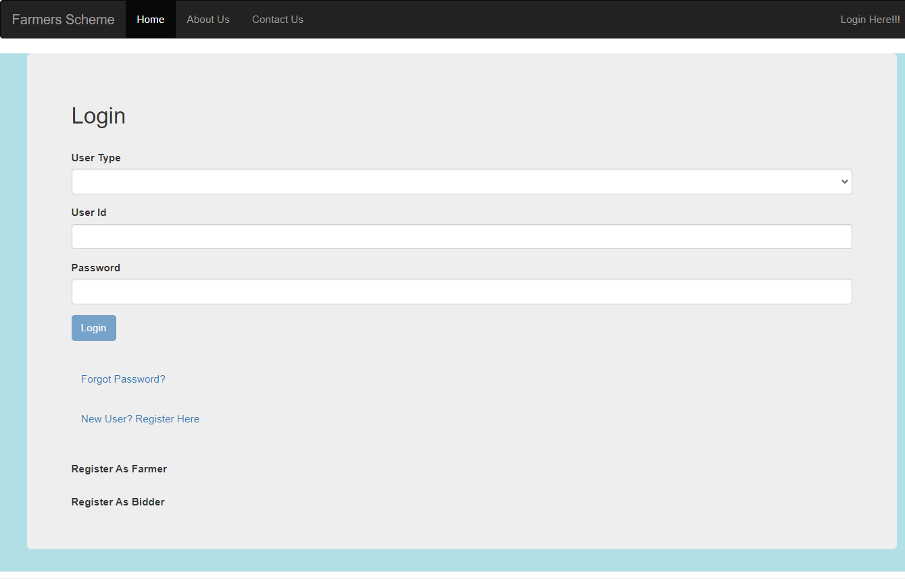
Login Page

Slide 6
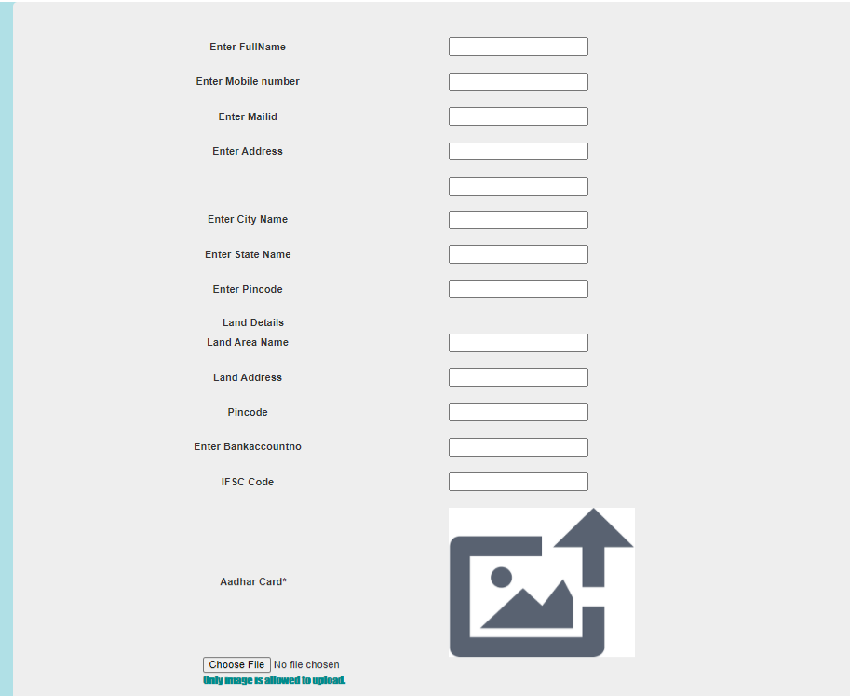
Farmer Registration Form output

Slide 7
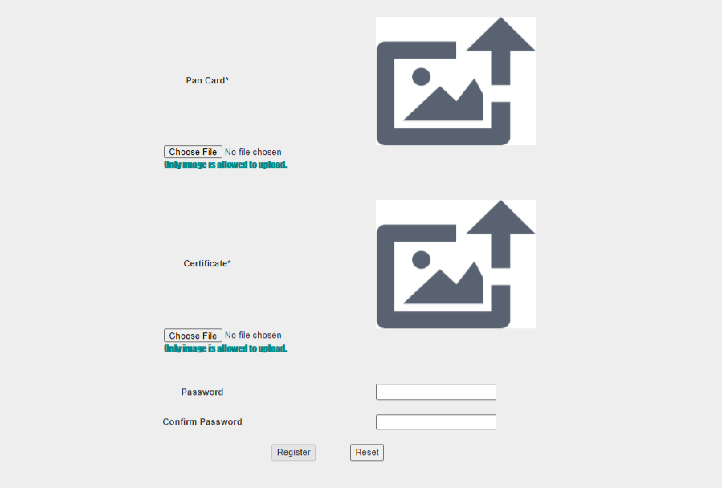
Farmer Registration Form output

Slide 8
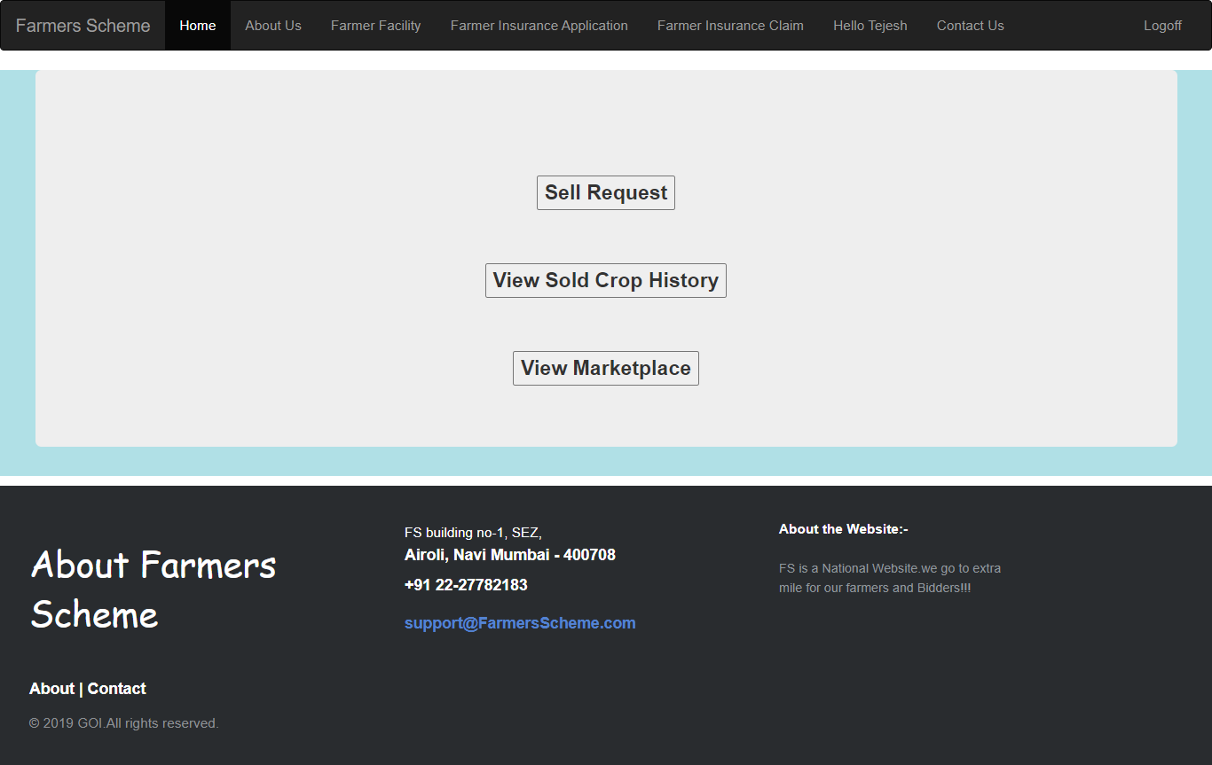
Farmer Facility

Slide 9
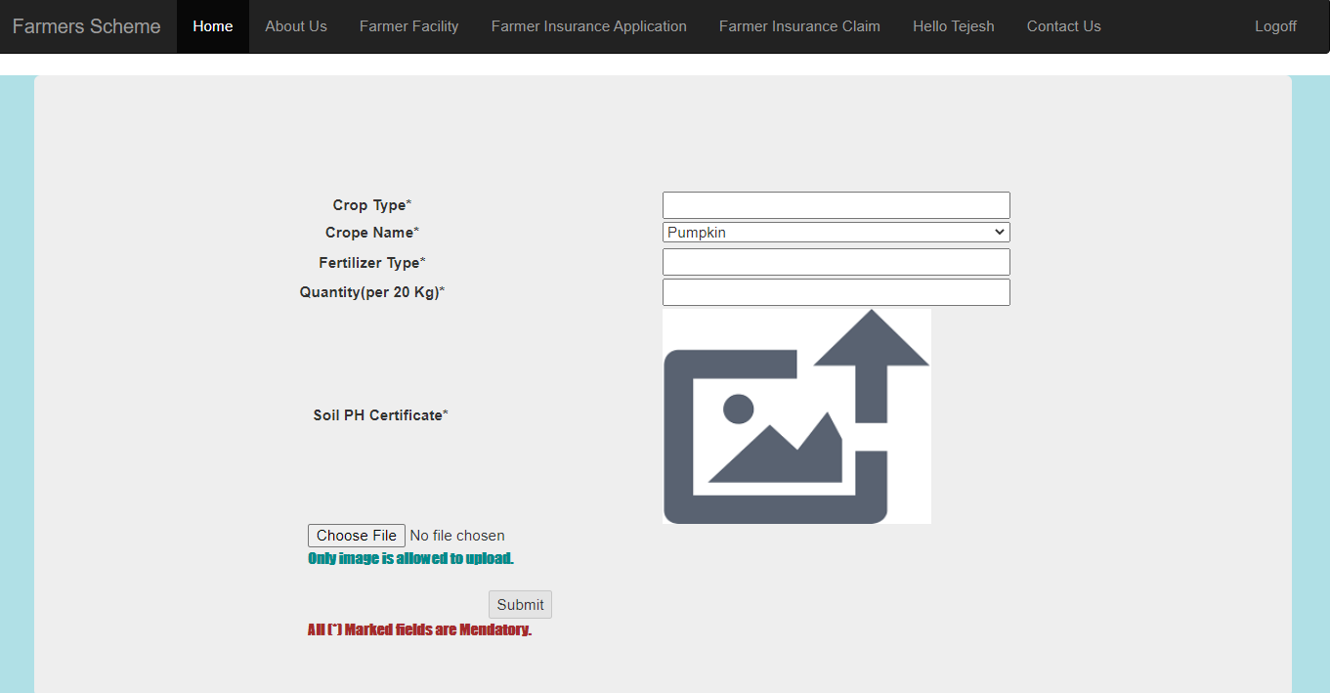
Farmer sell Request

Slide 10
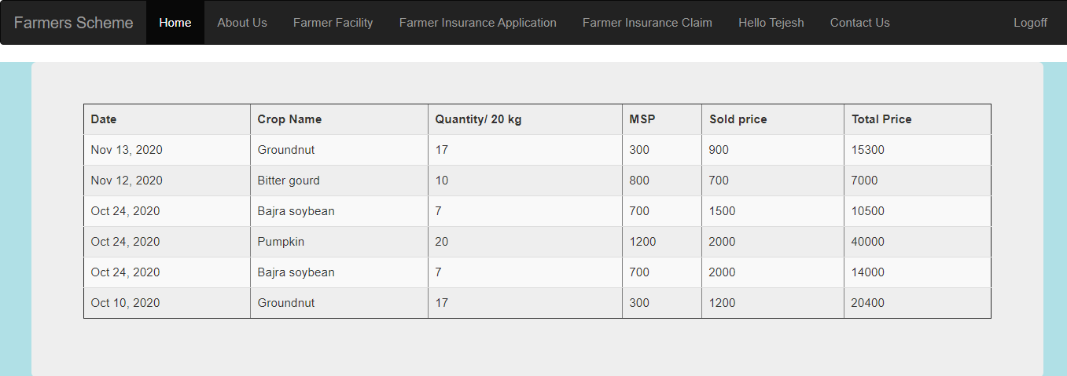
Sold history output

Slide 11
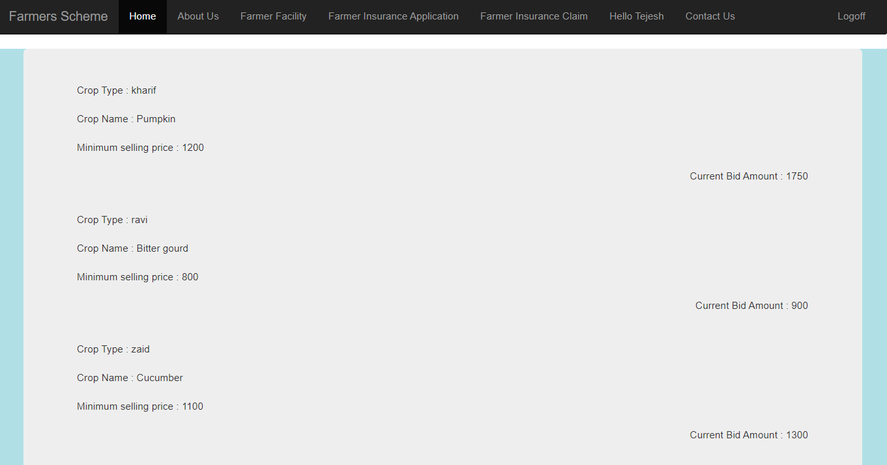
View Market Place output

Slide 12
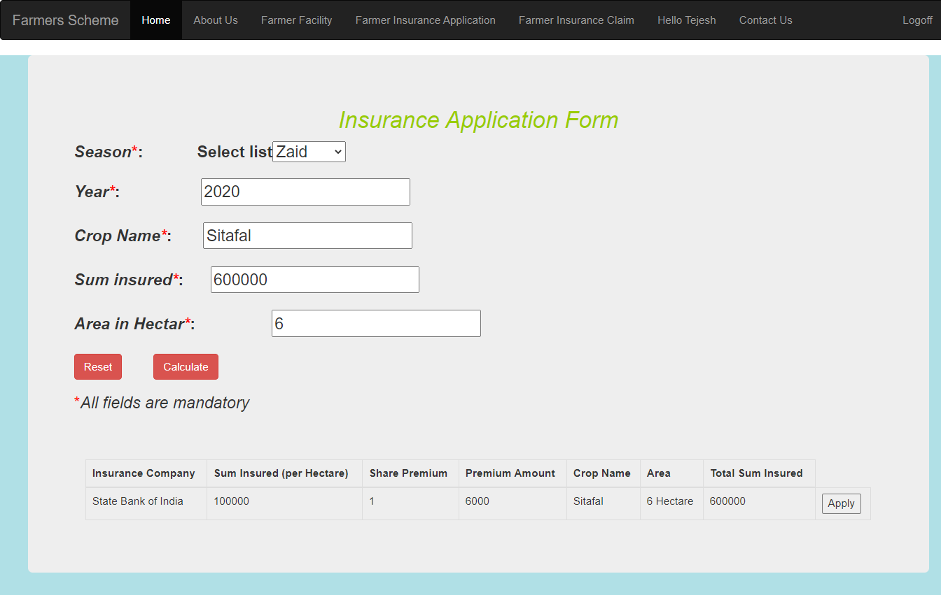
Insurance Application

Slide 13
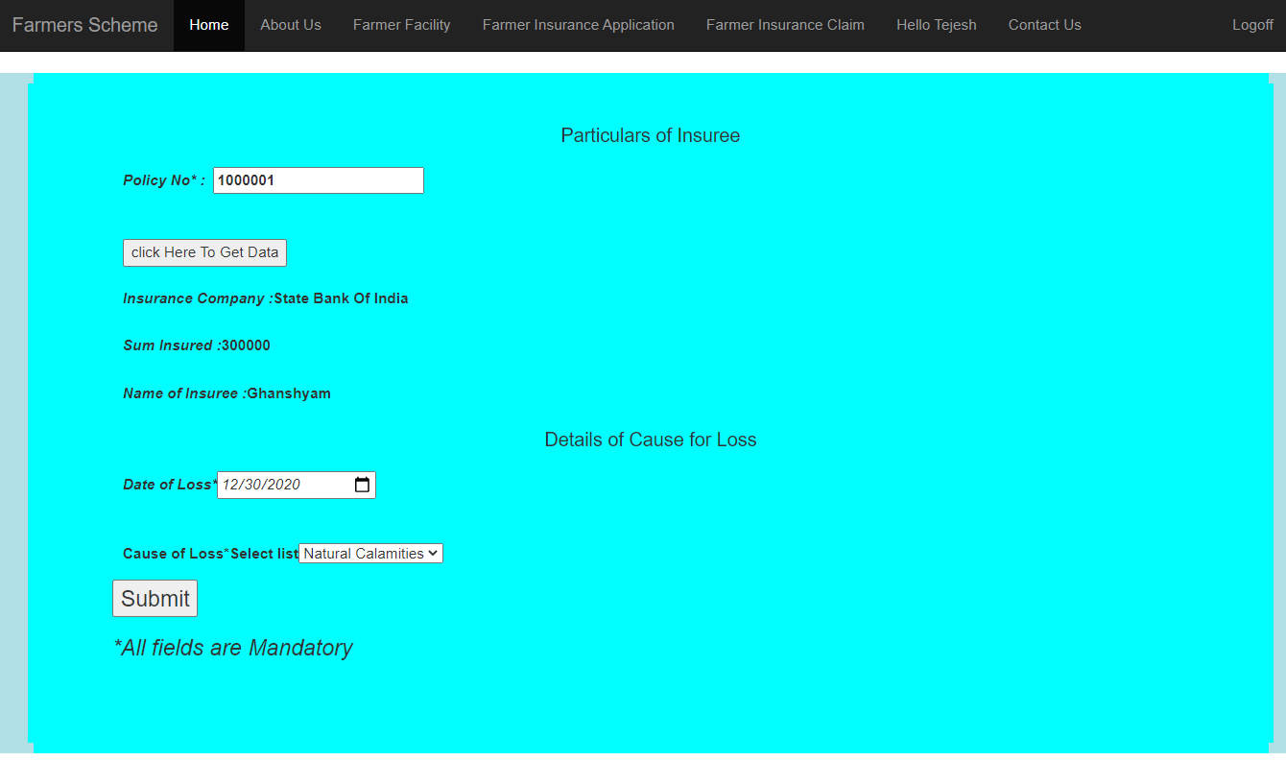
Claim insurance

Slide 14
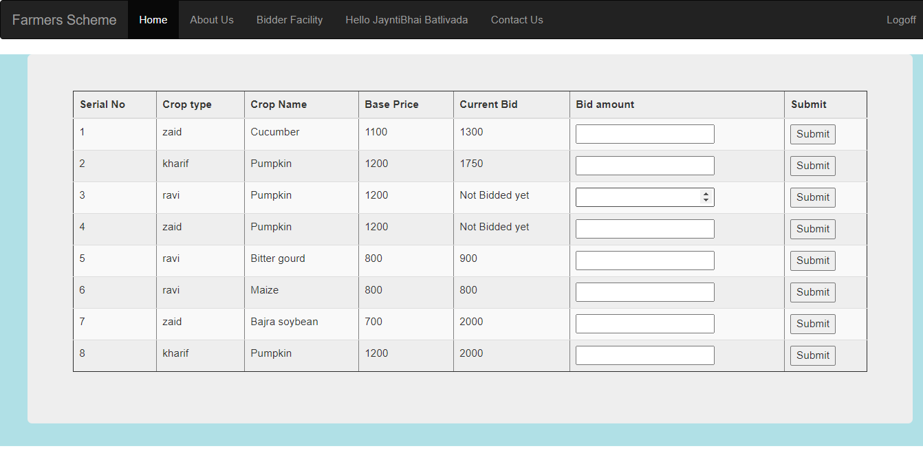
Bidder Facility

Slide 15
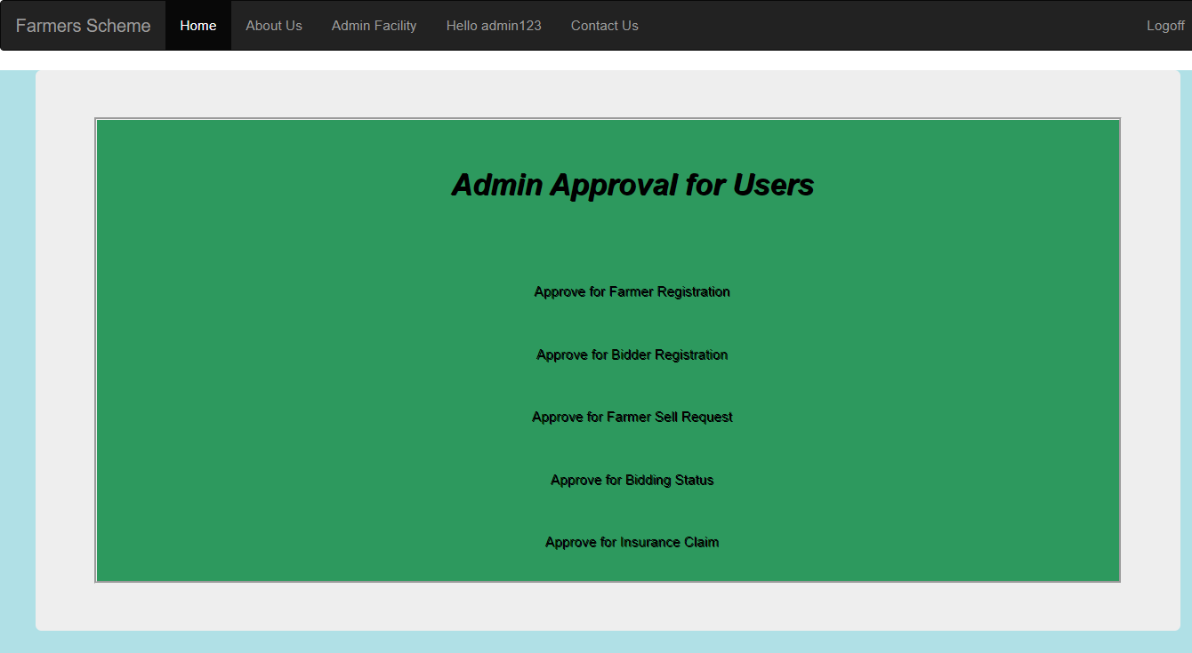
Admin Facility

Slide 16
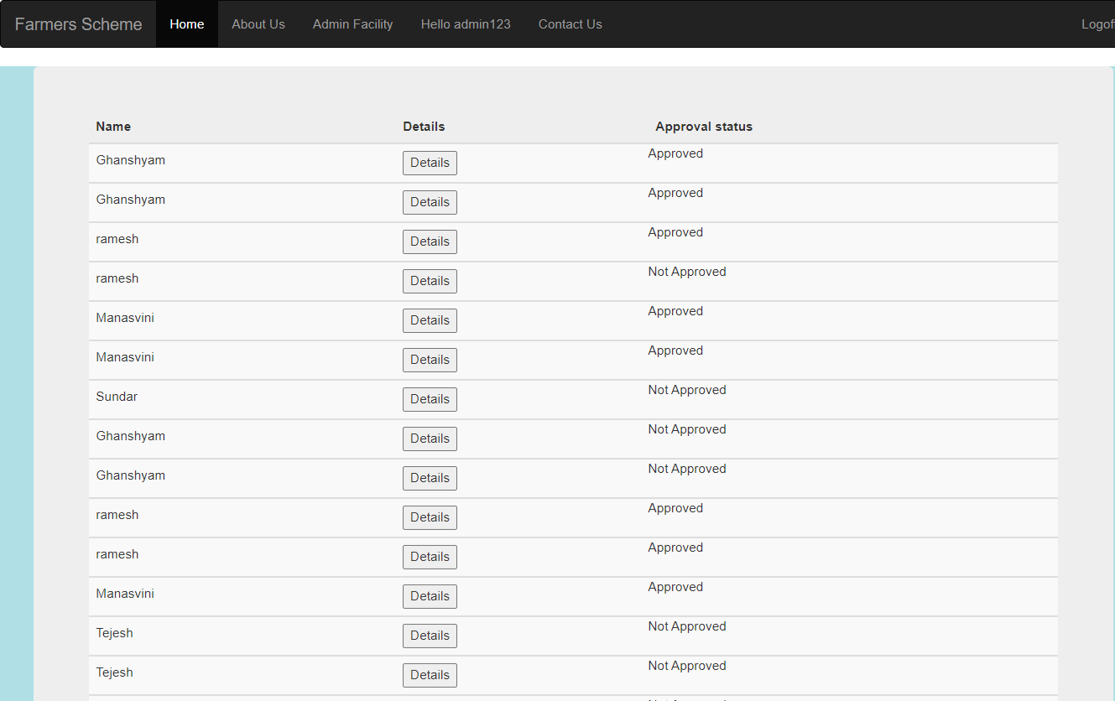
Admin Approval for Farmer Sell Request

Slide 17
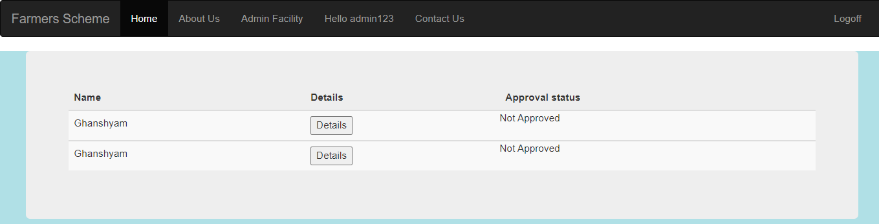
Admin Insurance Claim Approval

Slide 18
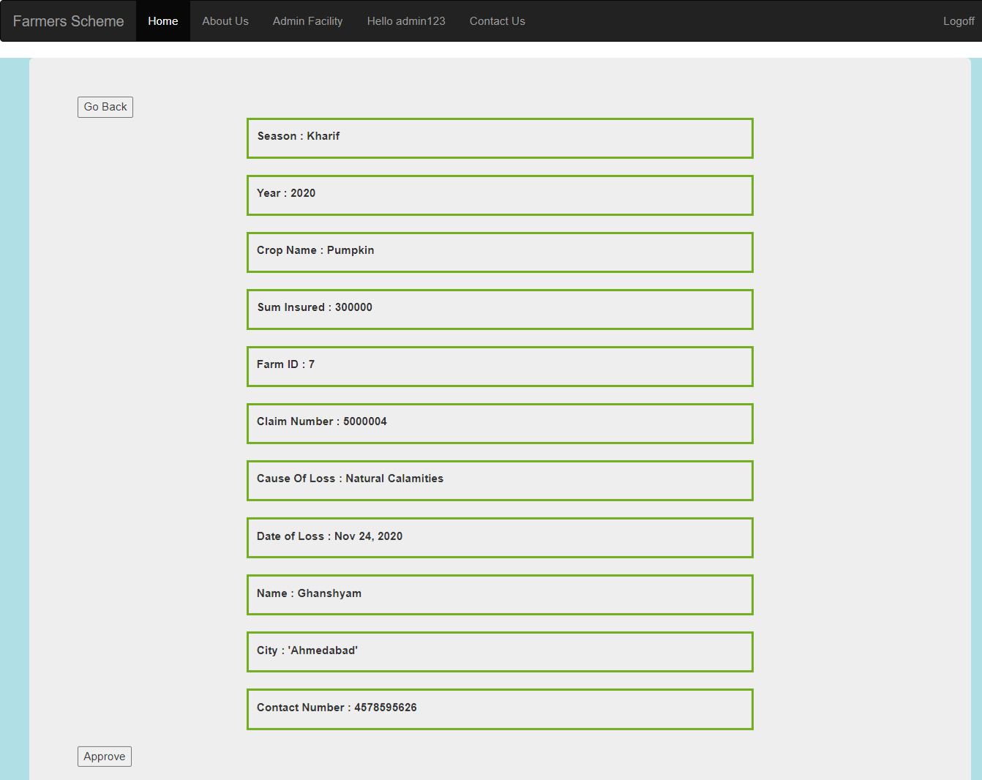
Admin approval to validate the claim details

Slide 19
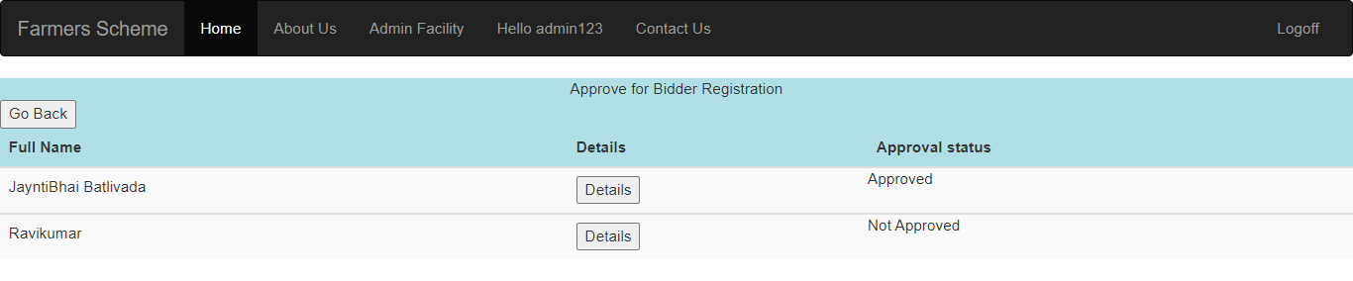
Admin Bidder Registration Details

